Slide 1


RSNA Screening Mammography Breast Cancer Detection
Marc Kolb

Slide 2

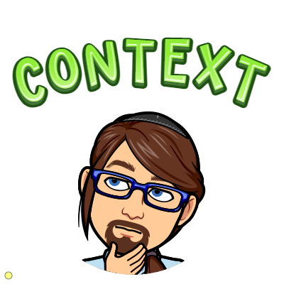
Breast Cancer
Most common cancer in women in the United States, except for skin cancers.
It is about 30% of all new female cancers each year.

Slide 3
Fighting Breast Cancer
Early Detection
State-of-the-Art Treatment

Slide 4
Finding Breast Cancer
Routine Screening
Early Detection
Better Prognosis

Slide 5




Finding Breast Cancer
Early Detection
Computer Vision & Machine Learning

Slide 6
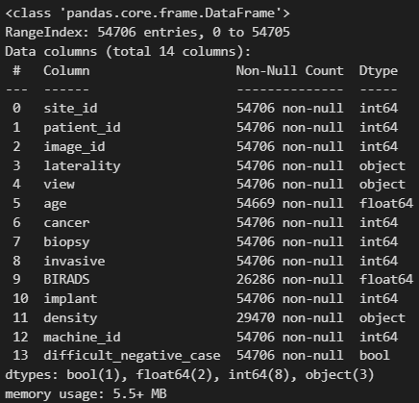


Data Sourced From Kaggle and RSNA
54,706
Dicom Images
of Routine
Mammograms

Slide 7
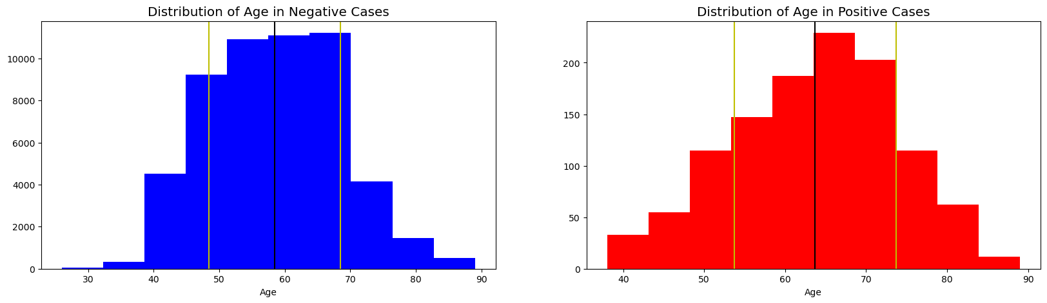
Age Distributions of Positive and Negative Cases
The average age in a negative case is: 58.43280820765824 .
The average age in a positive case is: 63.67875647668394 .

Slide 8
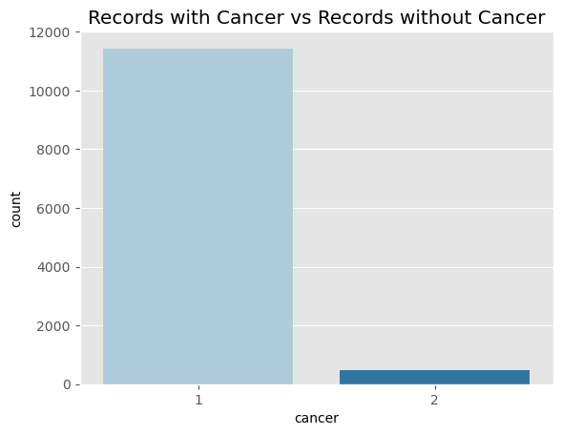

11907 Negative Cases
486 Positive Cases
Imbalanced Data

Slide 9
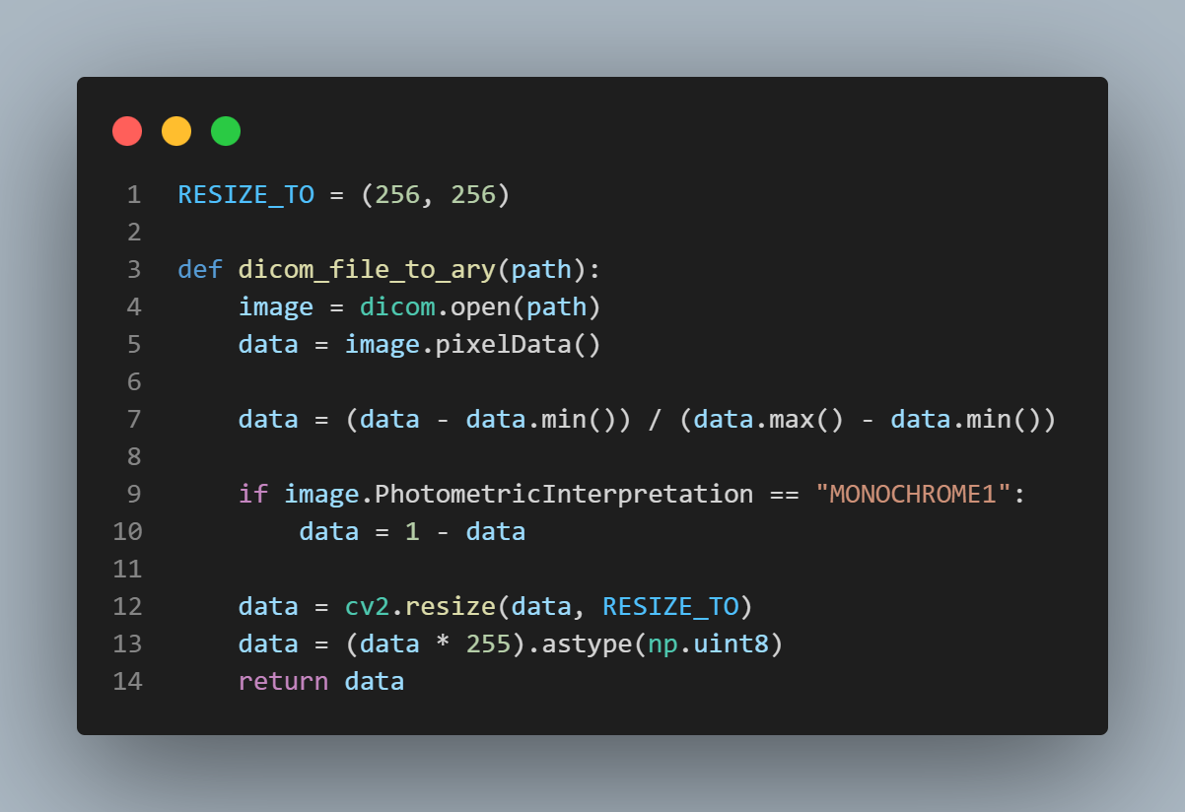
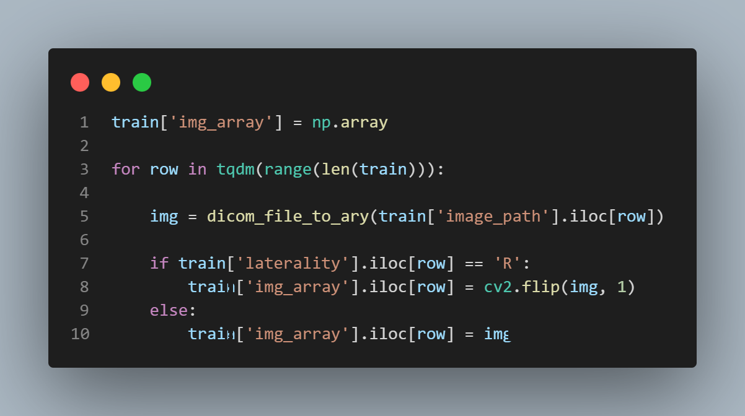
Converting Dicom image to Numpy array.

Slide 10
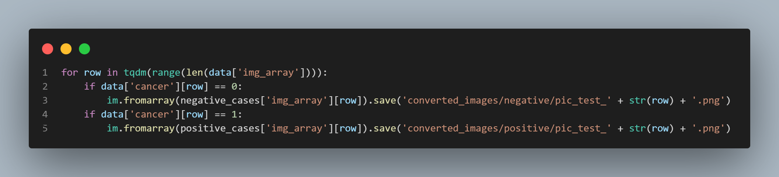
Positive Case PNGs
Negative Case PNGs

Slide 11


image_generator = ImageDataGenerator(
rescale=1/255,
rotation_range=10, # rotation
width_shift_range=0.2, # horizontal shift
height_shift_range=0.2, # vertical shift
zoom_range=0.2, # zoom
horizontal_flip=True, # horizontal flip
brightness_range=[0.2,1.2],# brightness
validation_split=0.2,)
Data Augmentation

Slide 12
Train & Validation Split
train_dataset = image_generator.flow_from_directory(
batch_size=32,
directory='converted_images',
shuffle=True,
target_size=(256, 256),
subset="training",
class_mode='categorical')
validation_dataset = image_generator.flow_from_directory(batch_size=32,
directory='converted_images',
shuffle=True,
target_size=(256, 256),
subset="validation",
class_mode='categorical')
Note:
Images were resized to 256 x 256 and normalized.

Slide 13
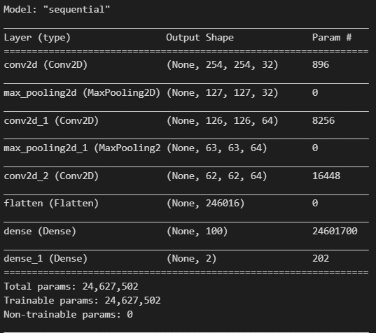
Convolutional Neural Network

Slide 14
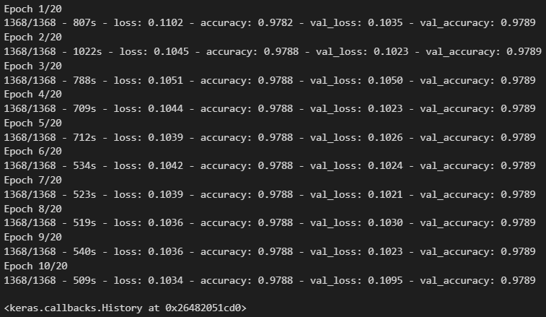
Fitting the Model

Slide 15

Loss: 0.10237234085798264
Accuracy: 0.9788848161697388

Slide 16

The results of this exercise indicate that, with a more balanced data-set, CNNs can approach the problem of breast cancer diagnostics in a faster and more efficient way. This can assist radiologists in the determination of whether cancer is present and where it is based on the features our model has presented. This model can be further tuned to detect smaller and less detectable cancers in the future.

